Slide 1
Module 3 Critical Thinking Assignment : Option #1: Business Intelligence Requirements
Colorado State University – Global
Daniel Folsom

Slide 2
Organizational Background: Office of Policy and Management (Connecticut)
The Office of Policy and Management (OPM) was created in 1977
“[Plays] a central role in [Connecticut's] state government, providing information and analysis used to formulate public policy for the State and assisting State agencies and municipalities” (OPM Background, n.d.).
7 divisions which are: Administration, Budget and Financial Management, Criminal Justice Policy and Planning Division, Finance, Intergovernmental Policy and Planning Division, Labor Relations, and Health and Human Services Policy and Planning Division
Notes:
The Office of Policy and Management (OPM) was created in 1977 and “plays a central role in [Conneticut’s] state government, providing information and analysis used to formulate public policy for the State and assisting State agencies and municipalities” (OPM Background, n.d.). The office consists of 7 divisions which are: Administration, Budget and Financial Management, Criminal Justice Policy and Planning Division, Finance, Intergovernmental Policy and Planning Division, Labor Relations, and Health and Human Services Policy and Planning Division. The Finance division is likely the division where the dataset of Real Estate Sales 2001-2018 resides. Likely the information was given to help explain possible policy initiatives for the Governor’s office in the State of Connecticut.

Slide 3
Dataset and Business Problem
Connecticut website for public data (ct.data.gov)
Dataset Name : Real Estate Sales 2001-2018
871,667 Real estate Sales Recorded
Data was cleaned and non-residential real estate was eliminated
Because of Processing limitations only 2014-2018 were analyzed (~250,000 records)
What factors led to an increase in home sale prices?
Possible Variables in the data set were list year, sale recorded date, town, address, assessed value, sales ratio, property type, residential type, non-use code, assessor remarks, location and opm remarks.
Notes:
The Real Estate Sales dataset was likely initiated to help solve policy questions when it comes to housing. The housing market has a significant impact on the citizens of the state and trying to help encourage more homeownership and more affordable housing is a policy initiative of every governor. Along with the desire to achieve those two goals, one of the possible business or policy problems could be phrased as what factors led to an increase in home sale prices. Additionally, is there a model that can accurately represent these factors and predict home sale price?
The dataset used to address this problem, Real Estate Sales 2001-2018, has several factors that could potentially influence sale price. Possible variables to consider in the dataset were list year, sale recorded date, town, address, assessed value, sales ratio, property type, residential type, non-use code, assessor remarks, location and opm remarks. Some of these variables were excluded from analysis for various reasons. Sale-recorded date was excluded in favor of just using the list year, sales ratio was excluded because it is a direct ratio of assessed value and sale amount (including the ratio a second time would be redundant). Address was not used because of processing limitations. Town was changed to a variable to assess if the town was a coastal city or not (yes or no). Property type was excluded in favor of filtering for only residential properties and then having categorical variables for apartment, condo, single family home, and multi family home. Non-use code was used as a variable but was changed to a binary option of having a non-use code or not having a code. This was because of the hundreds of possible categories for non-use codes. Assessor remarks were not deemed usable because of the many possible varying remarks. Location was excluded because of the lack of necessary programs to assess coordinate locations.
The real-time applications of this real-estate data are very real. The state most likely receives paperwork on each real estate sale in the state. If the data is useful for policy initiatives it could be tracked in semi-real time as soon as the paperwork is uploaded to state systems. This information could be given to a real-time dashboard, but may also be possible to have the information given to policy makers on a weekly, monthly, or quarterly basis.

Slide 4
How Dataset was Changed?
Variables taken out:
Remarks
Sale-recorded date taken out and used the list year instead
Sales ratio was just a direct ratio of assessed value and sale amount
Town had too many categories for a categorical variable
Instead used coastal city or not as a variable
Non-use code just a yes or no
Only used residential properties and changed some residential categories
Notes:
Some of these variables were excluded from analysis for various reasons. Sale-recorded date was excluded in favor of just using the list year, sales ratio was excluded because it is a direct ratio of assessed value and sale amount (including the ratio a second time would be redundant). Address was not used because of processing limitations. Town was changed to a variable to assess if the town was a coastal city or not (yes or no). Property type was excluded in favor of filtering for only residential properties and then having categorical variables for apartment, condo, single family home, and multi family home. Non-use code was used as a variable but was changed to a binary option of having a non-use code or not having a code. This was because of the hundreds of possible categories for non-use codes. Assessor remarks were not deemed usable because of the many possible varying remarks. Location was excluded because of the lack of necessary programs to assess coordinate locations.

Slide 5
Real Time-Applications
Paperwork could be updated to an online dashboard
Updates would occur when the paperwork is updated by state workers
Dashboard could give updates on housing sale prices for the state
Reports could also be given to policy makers on a weekly, monthly or quarterly basis.
Notes:
The real-time applications of this real-estate data are very real. The state most likely receives paperwork on each real estate sale in the state. If the data is useful for policy initiatives it could be tracked in semi-real time as soon as the paperwork is uploaded to state systems. This information could be given to a real-time dashboard, but may also be possible to have the information given to policy makers on a weekly, monthly, or quarterly basis.

Slide 6
Description of BI Tools
SAS Software
“SAS is a powerful statistical software which caters to the demands in high-performance computing environments” (Ganesan et al., 2004).
Used to perform multiple regression analysis on the dataset
Microsoft Excel
Clean Data
“The first task in [analyzing] any set of data is to check the data for obvious errors and anomalies” (Hunt & Tyrrell, 2002)
VLOOKUP to change variables (coastal towns and population)
Notes:
Two business intelligence tools used were Microsoft Excel and SAS software. These tools were used for two distinct purposes: data cleaning and for multiple regression analysis. One author noted the importance of data cleaning by saying, “The first task in [analyzing] any set of data is to check the data for obvious errors and anomalies” (Hunt & Tyrrell, 2002). The author continues to explain how Microsoft Excel is a perfect candidate for this task. I used Excel’s filtering features to filter out data like non-residential real estate listings. I also used it to change the town variable to a coastal town or not variable. This was done by using VLOOKUP and using a table of potential coastal cities and allowing a yes or no response to that question for each sale. The VLOOKUP function was also used to have population of the town be a variable. Instead of the town name, VLOOKUP would put the population of the town for each house listing.
For regression analysis, a program was needed that would have the capability to process and interpret the variables we would test against it. Excel’s functionality can be limited on the number of variables so another program, SAS was chosen. One author explained that “SAS is a powerful statistical software which caters to the demands in high-performance computing environments” (Ganesan et al., 2004). This high-performance is what was needed for our regression analysis.

Slide 7
Description of Data Visualization Tools
Tableau Software
“Tableau’s key benefit is that users can transform large amounts of data into effective visualization reports with a quick and easy-to-use interface” (Eaton & Baader, 2018)
Able to visualize variables and get a good idea of what the dataset looked like before additional analysis was chosen
Notes:
Description of Data Visualization Tools Used
Data visualization was performed by using Tableau to look at the variables in the dataset. As one author explained, “Tableau’s key benefit is that users can transform large amounts of data into effective visualization reports with a quick and easy-to-use interface” (Eaton & Baader, 2018). This was done originally for this dataset to get a good idea what the variables in the dataset looked like before additional analysis was chosen to be performed.

Slide 8
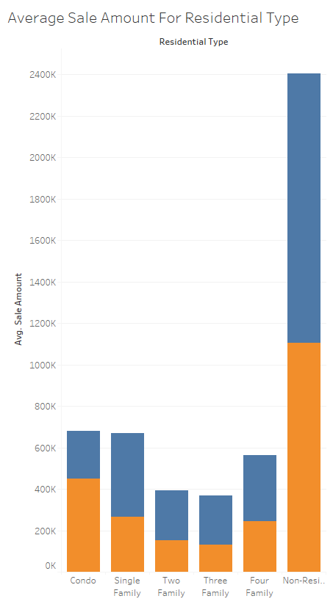
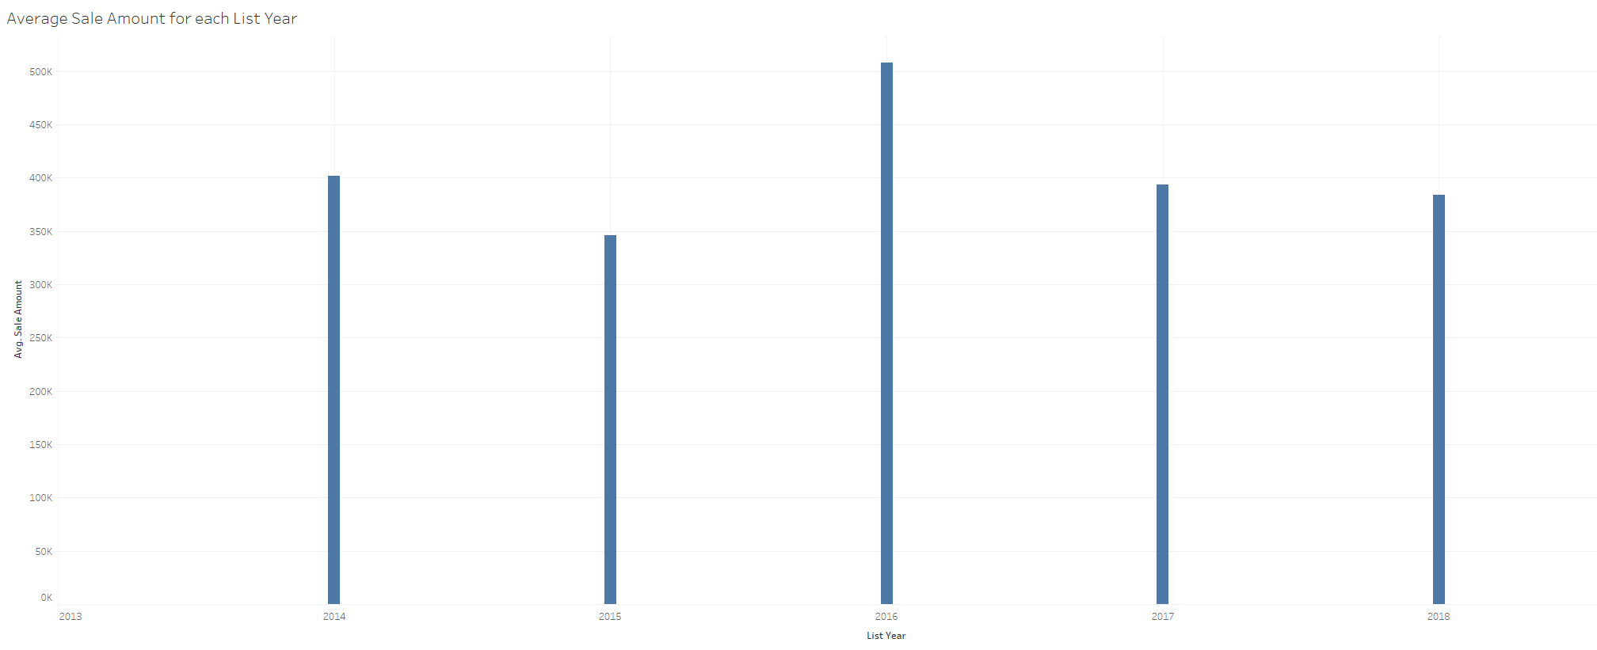
Notes:
To perform multiple regression analysis on the dataset, SAS software was used to determine significant factors and the viability of the model. Categorical variables were changed to dummy variables so that regression would be possible. The first program run was a regression program with all possible regression variables that would influence the sale amount.
The first regression analysis with all of the variables did not deliver a very promising R-squared. Which did not give us a good feeling about the current model explaining the variation in the model. Our hope was that by looking for the strongest predictors that we could have the model explain more of the variation. It became apparent that many of the variables that I might have expected to be strong predictors were not, such as population or being in a coastal city or not. The strongest indicators were actually the list years of 2015 and 2017. So, year was the only strong predictor in this model. But even with the strongest predictors, the model still only accounted for 0.1% of the variation in the data.

Slide 9
Code Explanation
Used SAS to perform regression analysis of all chosen variables
Notes:
To perform multiple regression analysis on the dataset, SAS software was used to determine significant factors and the viability of the model. Categorical variables were changed to dummy variables so that regression would be possible. The first program run was a regression program with all possible regression variables that would influence the sale amount.
The first regression analysis with all of the variables did not deliver a very promising R-squared. Which did not give us a good feeling about the current model explaining the variation in the model. Our hope was that by looking for the strongest predictors that we could have the model explain more of the variation. It became apparent that many of the variables that I might have expected to be strong predictors were not, such as population or being in a coastal city or not. The strongest indicators were actually the list years of 2015 and 2017. So, year was the only strong predictor in this model. But even with the strongest predictors, the model still only accounted for 0.1% of the variation in the data.

Slide 10
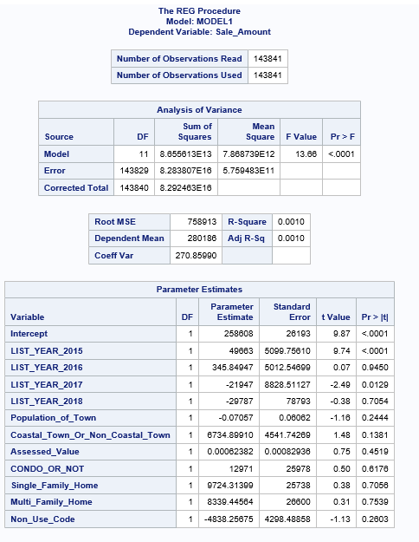
Notes:
To perform multiple regression analysis on the dataset, SAS software was used to determine significant factors and the viability of the model. Categorical variables were changed to dummy variables so that regression would be possible. The first program run was a regression program with all possible regression variables that would influence the sale amount.
The first regression analysis with all of the variables did not deliver a very promising R-squared. Which did not give us a good feeling about the current model explaining the variation in the model. Our hope was that by looking for the strongest predictors that we could have the model explain more of the variation. It became apparent that many of the variables that I might have expected to be strong predictors were not, such as population or being in a coastal city or not. The strongest indicators were actually the list years of 2015 and 2017. So, year was the only strong predictor in this model. But even with the strongest predictors, the model still only accounted for 0.1% of the variation in the data.

Slide 11
Code Explanation (CONT.)
First regression analysis did not show expected variables as strong predictors (population or coastal location)
List year 2015 and List year 2017 were the only significant predictors
7 different combinations were tried to see if that influenced any other variables to be better predictors
With list year 2015 and list year 2017 as only predictors, r-squared was only 0.1%.
Notes:
To perform multiple regression analysis on the dataset, SAS software was used to determine significant factors and the viability of the model. Categorical variables were changed to dummy variables so that regression would be possible. The first program run was a regression program with all possible regression variables that would influence the sale amount.
The first regression analysis with all of the variables did not deliver a very promising R-squared. Which did not give us a good feeling about the current model explaining the variation in the model. Our hope was that by looking for the strongest predictors that we could have the model explain more of the variation. It became apparent that many of the variables that I might have expected to be strong predictors were not, such as population or being in a coastal city or not. The strongest indicators were actually the list years of 2015 and 2017. So, year was the only strong predictor in this model. But even with the strongest predictors, the model still only accounted for 0.1% of the variation in the data.

Slide 12
Description of Analytics Outcomes and Benefits
Model cannot be used as a predictive model to explain sale amount
Policy makers would need to look at other variables to explain
square footage, number of rooms, garage or no, swimming pool or no, yard square footage, etc.
Different data would need to be collected to find a solution
Notes:
This model cannot be used as a predictive model to help explain the sale amount in this real estate dataset. If this question is needed to help policy makers, then it would be necessary to look at changing some of the data collected. Perhaps, other variables like square footage, number of rooms, garage or no, swimming pool or no, yard square footage, and other factors could possibly influence sale price and help to explain the model in a better way. The only benefit from running this model is by realizing that these variables do not bring us closer to arriving at a solution for the business problem. However, it does bring us closer to trying to collect a better dataset that may be able to answer our questions and if new collection requirements are approved by the Office of Policy Management, then we may be able to have a greater outcome and potential benefits.

Slide 13
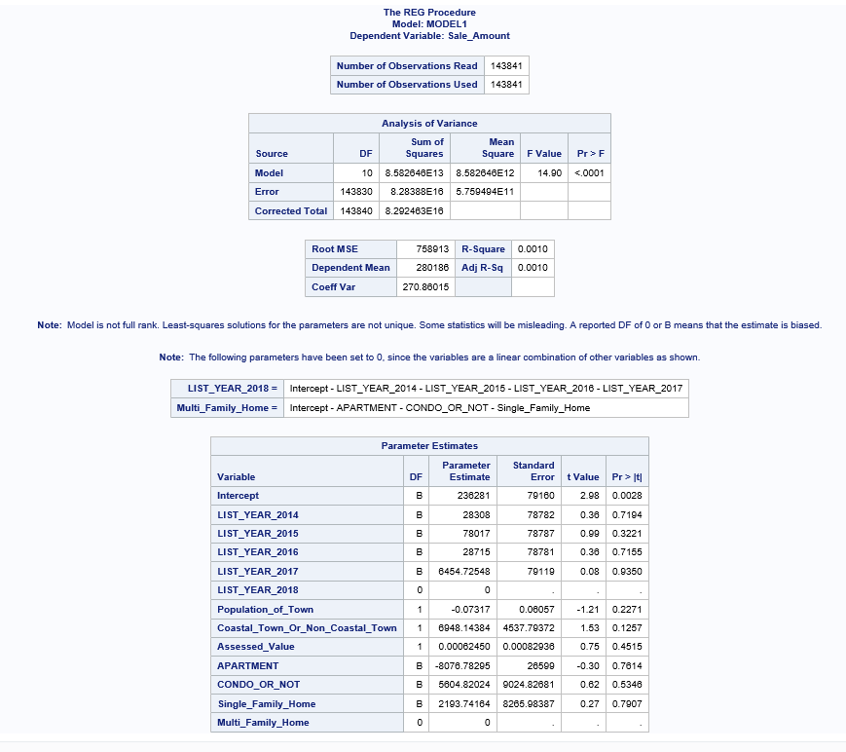
Rationale for Selecting Tableau (Cont.)
(Pedakota, 2019)
Notes:
PROGRAM#1
proc reg data=WORK.IMPORT;
model Sale_Amount=LIST_YEAR_2014 LIST_YEAR_2015 LIST_YEAR_2016
LIST_YEAR_2017 LIST_YEAR_2018 Population_of_Town Coastal_Town_Or_Non_Coastal_Town Assessed_Value APARTMENT CONDO_OR_NOT Single_Family_Home Multi_Family_Home;
run;

Slide 14
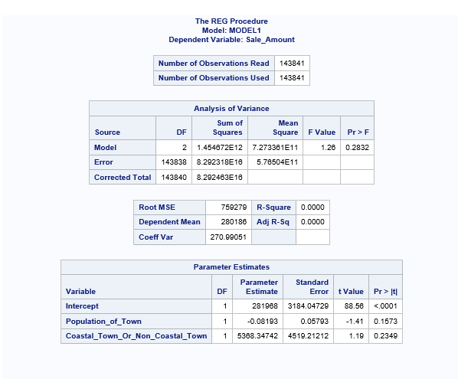
Rationale for Selecting Tableau (Cont.)
(Pedakota, 2019)
Notes:
PROGRAM#2
roc reg data=WORK.IMPORT;
model Sale_Amount=Population_of_Town Coastal_Town_Or_Non_Coastal_Town;

Slide 15
Rationale for Selecting Tableau (Cont.)
(Pedakota, 2019)
Notes:
PROGRAM#3
proc reg data=WORK.IMPORT1;
model Sale_Amount=LIST_YEAR_2015 LIST_YEAR_2016
LIST_YEAR_2017 LIST_YEAR_2018 Population_of_Town
Coastal_Town_Or_Non_Coastal_Town Assessed_Value CONDO_OR_NOT Single_Family_Home Multi_Family_Home
non_use_code;
run;

Slide 16
Rationale for Selecting Tableau (Cont.)
(Pedakota, 2019)
Notes:
PROGRAM#4
proc reg data=WORK.IMPORT;
model Sale_Amount=LIST_YEAR_2014 LIST_YEAR_2015 LIST_YEAR_2016
LIST_YEAR_2017 LIST_YEAR_2018 Population_of_Town Coastal_Town_Or_Non_Coastal_Town Assessed_Value APARTMENT CONDO_OR_NOT Single_Family_Home Multi_Family_Home;
run;

Slide 17
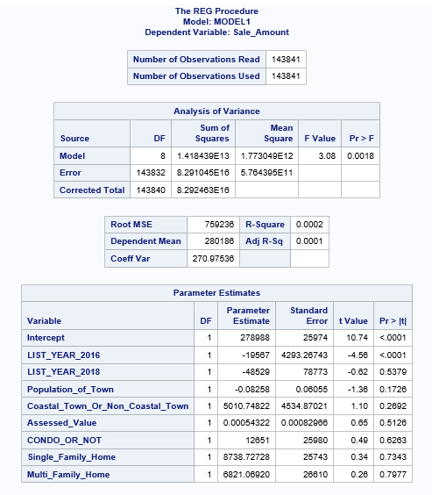
Rationale for Selecting Tableau (Cont.)
(Pedakota, 2019)
Notes:
PROGRAM#5
proc reg data=WORK.IMPORT1;
model Sale_Amount=LIST_YEAR_2016 LIST_YEAR_2018 Population_of_Town
Coastal_Town_Or_Non_Coastal_Town Assessed_Value CONDO_OR_NOT Single_Family_Home Multi_Family_Home;
run;

Slide 18
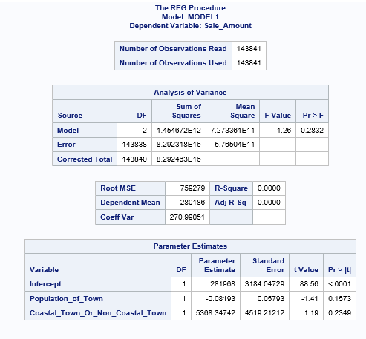
Rationale for Selecting Tableau (Cont.)
(Pedakota, 2019)
Notes:
PROGRAM#6
proc reg data=WORK.IMPORT1;
model Sale_Amount=Population_of_Town Coastal_Town_Or_Non_Coastal_Town;
run;

Slide 19
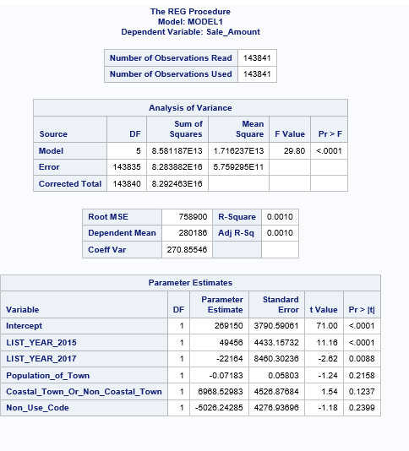
Rationale for Selecting Tableau (Cont.)
(Pedakota, 2019)
Notes:
PROGRAM#7
proc reg data=WORK.IMPORT1;
model Sale_Amount=LIST_YEAR_2015 LIST_YEAR_2017 Population_of_Town Coastal_Town_Or_Non_Coastal_Town non_use_code;
run;

Slide 20
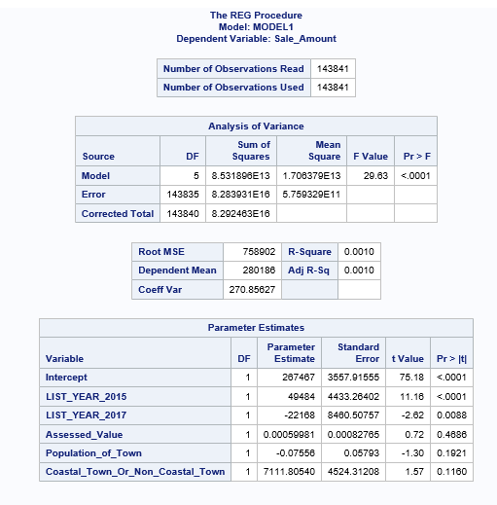
Rationale for Selecting Tableau (Cont.)
(Pedakota, 2019)
Notes:
PROGRAM#8
proc reg data=WORK.IMPORT1;
model Sale_Amount=LIST_YEAR_2015 LIST_YEAR_2017 assessed_value Population_of_Town Coastal_Town_Or_Non-Coastal_Town;
run;

Slide 21
References
Connecticut Cities by Population. Connecticut Outline. (n.d.). https://www.connecticut-demographics.com/cities_by_population.
Eaton, T. V., & Baader, M. (2018). Data Visualization Software. CPA Journal, 88(6), 50–53.
Ganesan, R., Sampath, V., Okogbaa, O. G., Polavarapu, I., & Weatherspoon, M. (2004). Regression and ANOVA: An Integrated Approach Using SAS Software (Book). IIE Transactions, 36(12), 1211–1216. https://doi.org/10.1080/07408170490507855
Hunt, N., & Tyrrell, S. (2002). Cleaning Dirty Data in Excel. Teaching Statistics, 24(3), 90–92. https://doi.org/10.1111/1467-9639.00096
OPM Background. CT.gov. (n.d.). https://portal.ct.gov/OPM/Root/About-OPM/OPM-Background.
Real Estate Sales 2001-2018 GL: Connecticut Data. State of Connecticut - Open Data. (2021, February 23). https://data.ct.gov/Housing-and-Development/Real-Estate-Sales-2001-2018-GL/5mzw-sjtu.
Wikimedia Foundation. (2020, April 25). Coastal Connecticut. Wikipedia. https://en.wikipedia.org/wiki/Coastal_Connecticut.

